Slide 1


Agribusiness Intensive
15–16 June 2023
Hilton Brisbane & Online

Slide 2
Session 13: Taxation issues arising from alternative land use of primary production land
Session 13
Presenter: David Hall, CTA, Findex

Slide 3

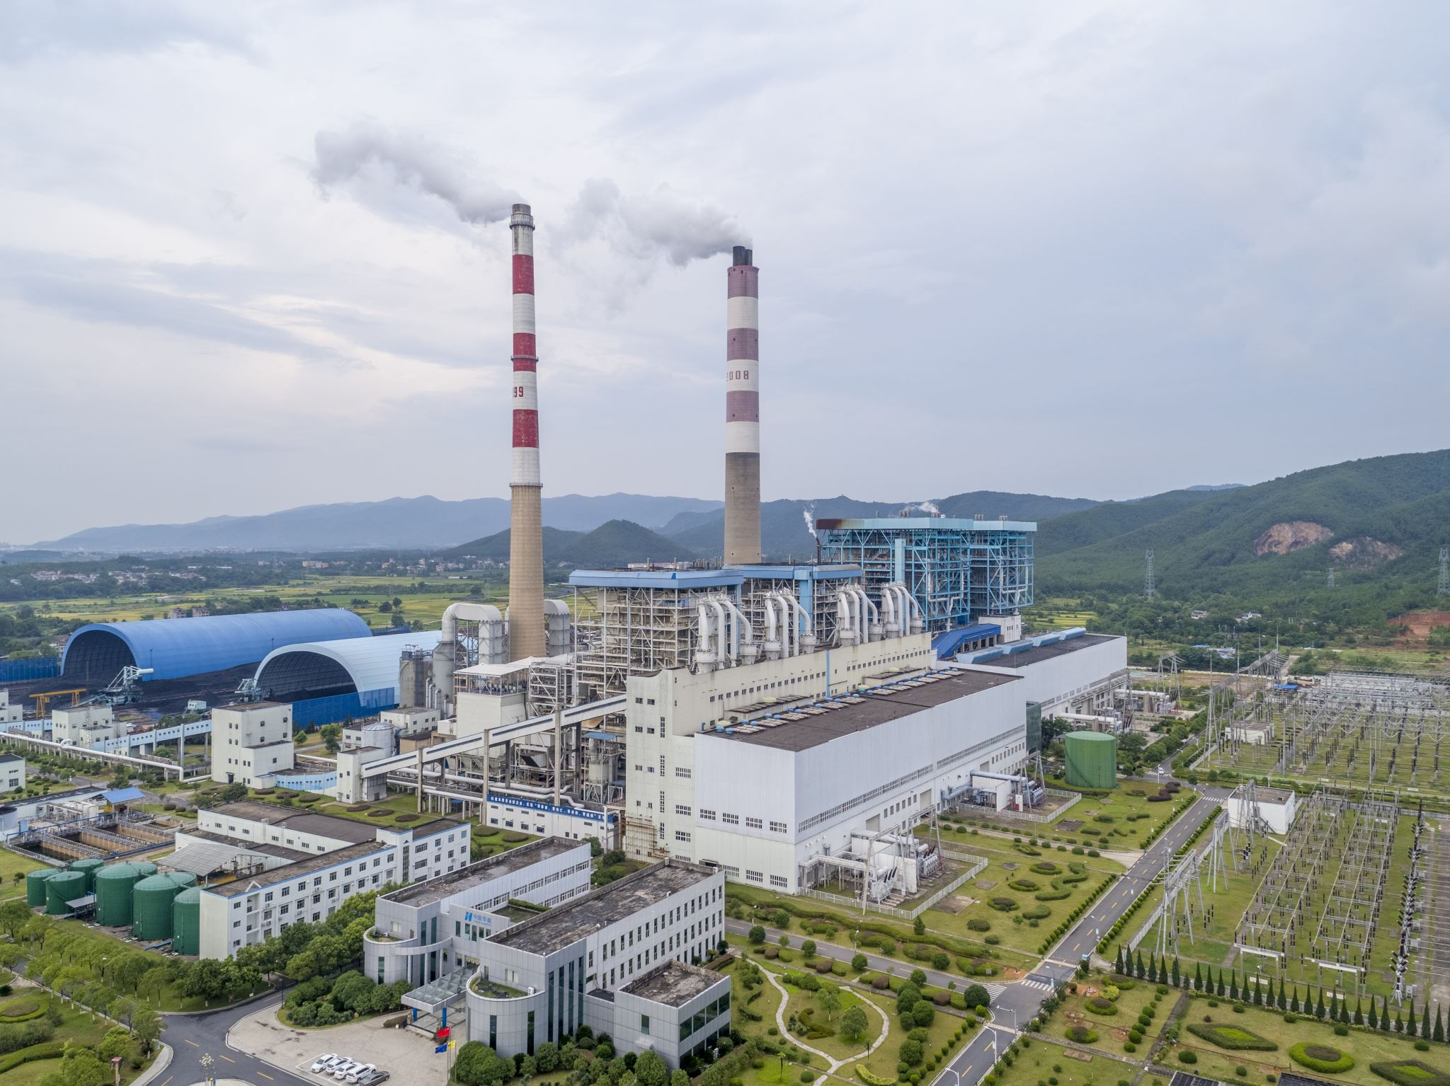

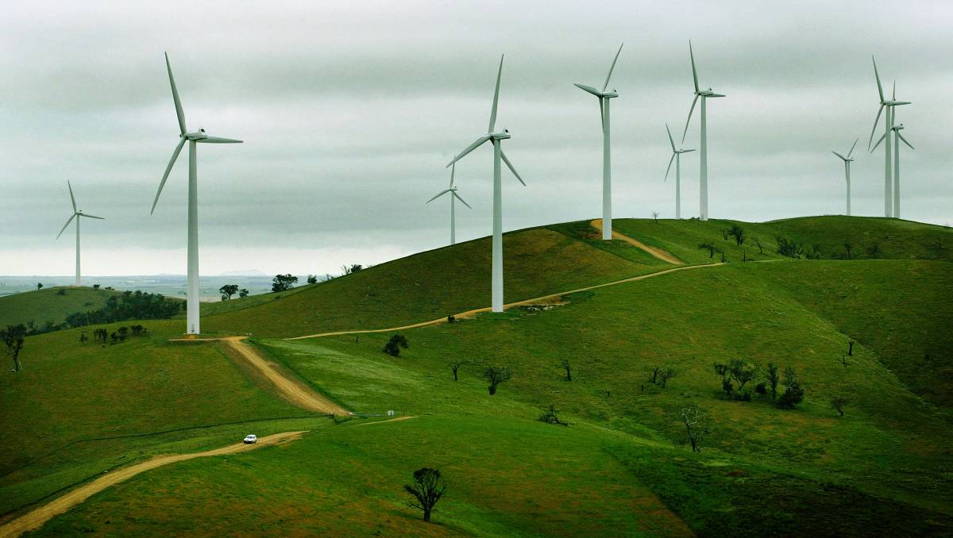
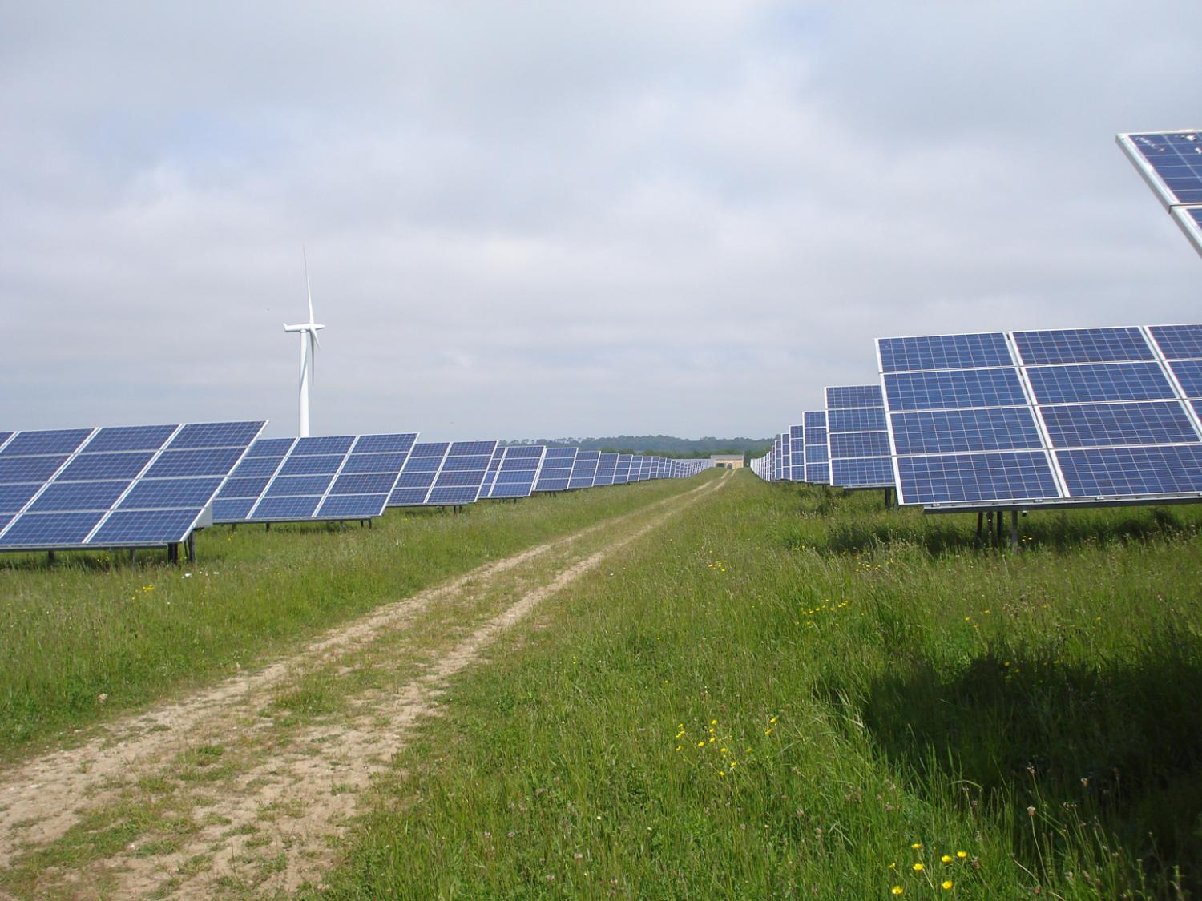
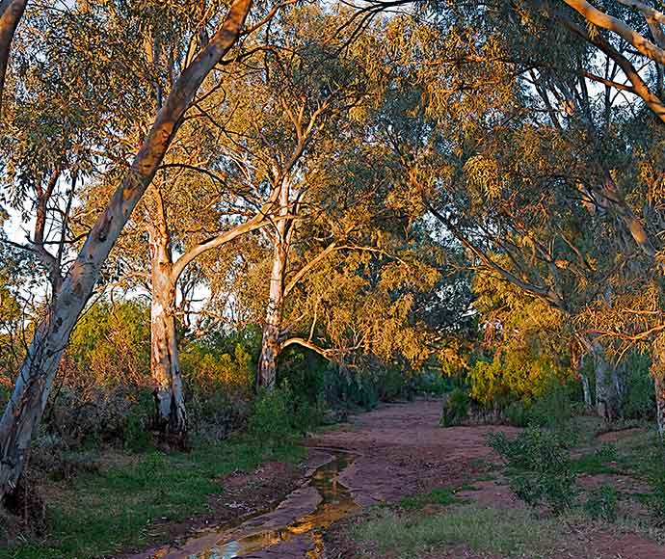
Overview
Compensation agreements
Why is the look through approach important
Diminution of surrounding land- a deep dive
A practical approach
The detail
Conservation agreements
Biodiversity agreements
Carbon
Wind and Solar Farms
Concurrent leases
Agri-tourism and farm stay
Notes:
Please note the paper has a different order of things with the compensation at the end.
This presentation will concentrate on the practical and provide examples and explanation. The paper instead provides you with the technical detail.
In relation to the various topics covered in my paper and today, I do not attempt to explain how the carbon and biodiversity systems work, nor on how the land owner applies for a conservation covenant. Instead the paper whist touching on these things only where necessary, concentrates on the tax considerations and outcomes.
I have left it for greater minds than me to explain such things as how the carbon system works , how to implement a biodiversity agreement etc.
This session today will provide some practical considerations to draw out the affected assets in compensation claims and ensure that those assets are accorded their rightful place in the agreement.
A practical example is provided.
I provide an example in tax accounting for ACCUs and incorporate the changes for primary producers in the current Bill before parliament.

Slide 4
Compensation agreements
The importance of the look through approach
The practical approach
Detriment to the surrounding land
Notes:
I do not intend to step through the case law and rulings in relation to compensation agreements, but rather concentrate on the practical aspects of the look through approach and the importance of doing so.
The look through approach is identifying the underlying asset in a compensation agreement. In the absence of identifying the underlying asset the default position is that the amount of compensation is potentially for the right to compensation.
If the only asset identified is the right to compensation, then this may well be the worse tax outcome and importantly may not be reflective of what is commercially and practically is occurring.
Unfortunately, it is not uncommon for landowners to be presented with a draft agreement settling any claims they have with a one lump sum amount. The agreement will not allocate any values to the underlying assets or identify them, instead contract the landowner to forgo any future claims and as a final settlement.
The right to compensation should be considered an asset of last resort, not solely because of the tax outcome, but solely because it is the default position if an underlying asset cannot be identified.
An often overlooked category of an underlying asset is the detriment (being diminution of the value) of the surrounding land).In most cases the real cost to the land owner is the impact a gazetted road, or compulsorily acquired easement has on the surrounding land. A similar situation applies with the mining and coal seam gas imposts on land. The immediate focus may be on the installation and lack of use of a portion of the land.

Slide 5
Compensation outcomes
Component | Tax Outcome
Right to seek compensation | C2 event – may have very little cost base
The underlying asset being disposed of (including compulsory easement/resumption) | A1 event – apportion of cost base of land, 50% discount, pre-CGT, SBCGT?
The underlying asset that is expected to suffer permanent damage or permanently reduced in value including surrounding land | No CGT event, reduction in cost base s 110-40(3) & s110-45(3). May have a windfall gain.
Creation of a right? (easements – voluntary) | D1 event for creation, no 50% discount, no pre-cgt, little cost base May attract SBCGT
Compensation for additional costs? | Is this rightly part of the aspect of reduction in value of underlying and/or surrounding land or is income (s6-5, s20-20(2)
Loss of future income or disruption to business | Income, s6-5.
Reimbursement for services to be performed by landowner | Income, s6-5, s20-20(2)
Notes:
This slide highlights the importance of identifying the asset the compensation relates to. Getting it right may mean a better or worse outcome.
It gets relatively easy where the compensation is for damage to the underlying land in situations where mining and coal seam gas installations are involved.
But identifying the impact on the surrounding land and may be harder.
Where easements are created, attributing the amount to the creation of the easement can be relatively an easy affair, but identifying the decrease in value of the surrounding land becomes more difficult. Yet the tax outcomes can be significant.
It is not our job to value the various components of the compensatable amounts, rather it is our job to highlight and question the impact and discuss with the landowner, their legal adviser and a suitably qualified valuer to best ensure that all impact is taken into account, highlighted and appropriately valued or even discounted.
As tax advisers we must have one eye on the tax outcome.

Slide 6
Detriment to the land
Bob is a prospective purchaser of one of two properties on the market.
Both properties sit side by side (York & Barrow) and have the same characteristics.
One of the properties; York, has an easement created on the property, by the electricity authority, for high voltage power lines. The easement when recently created was valued at $200,000.
Barrow has no such easement.
All things considered would you expect Bob, as an astute buyer, to pay marketable different prices for the properties if he considered the easement and restrictions as having a real impact on how he conducts his business?
If the answer is yes, and the difference in the amount Bob would pay for Barrow over York exceeds $200,000, then the surrounding land has had detriment.

Slide 7
Factors that affect the value of the surrounding land
Detriment to property can include the decrease in value
What factors affect the value of the property
Actual resumption of part
Reduced use of property – restricted access to parts, damaged, polluted,
costs more to run the property- movement of machinery and cattle, introduction of pests and weeds
Notes:
The graph is just an attempt to show that as the restrictions and costs to run the property increase, because of the change in work practices to overcome the restrictions, the property value decreases.
Please note I am not trying to provide any measurement here – it is just for illustrative purposes.
Such things as splitting the property with an easement that restricts the use of the easement and access across the easement will reflect a decrease in value firstly for the reduced land that is useable, secondly the restriction may impact how you conduct your business.
Such things as movement of cattle and equipment may change and create a greater cost. Heavy equipment and cattle may need to be transported on road to parts of the property that is now cut off.
Mustering helicopters may not be able work within a range of powers lines and towers, requiring changes to how cattle are mustered.
Farming equipment may have to be transported to the separated property, taking extra time, cost etc.
This doesn’t mean that the compensation necessarily is a reimbursement of expenditure, but demonstrates that the value of the property will decrease with the higher costs to run the property.

Slide 8
Practical example

Slide 9
Granting an easement
Facts:
Bill owns a cattle property which he purchased 10 years ago for $5M. He is approached by Copper String with an offer of $1.2M to create an easement on his property, to install high voltage power poles.
Tax outcome:
D1? $1.2M CG, no discount, maybe SBCGT?

Slide 10
Granting an easement – compulsory acquisition Example
Facts (additional):
Copper Strings is an authority that has available compulsory powers of acquisition
Tax outcome:
A1 event: Apportion land cost base, 50% discount, possible SBCGT or asset rollover? Outcome: Nil Tax or some lower tax.

Slide 11
Granting an easement – compulsory acquisition Example
Additional facts:
The agreement restricts access for the landowner, requires fences to be erected and provide access to a side road for maintenance crew and installers.
Copper String can erect other structures on the site and retain the right to install underground pipes and cables in the easement.
Bill’s property is quite large, but the easement will split the back third of the property from the front.
We start to see some impact on the surrounding land!

Slide 12
Granting an easement – compulsory acquisition
Facts (continued):
Mustering is by helicopters being most efficient.
Organic farming practices- active cattle management to move cattle around the property, with extensive use of temporary electric fences.
Noxious weed infestation and exotic pests are becoming a real concern for property owners in the district.
Clearly there is a much bigger impact on how Bill can conduct his business on this property. Time to get his advisers involved further.

Slide 13
Granting an easement – compulsory acquisition
Example continues
Bill’s legal adviser outlines the restrictions Bill will have in conducting his cattle business.
His potential tax outcome under the current agreement versus an amended agreement is discussed.
Bill is also made aware that Copper String has to pay for a valuation and possibly even an economic impact review.
The valuer is briefed and offers additional impact expectations.

Slide 14
Granting an easement – compulsory acquisition- valuation report (example continues)
Valuer identifies:
Restrictions on mustering helicopter – no fly zones
Restrictions on use of electric fences within proximity of power lines.
Movement of cattle around easement either restricted or supervised crossing.
Free movement of vehicles in easement and lack of supervision of use of chemicals, may increase risk of organic certification and weed and pest control.

Slide 15
Granting an easement – compulsory acquisition- valuation report- example continues
The valuation report identifies various components:
Easement at $200,000
Diminution of surrounding land $1M
Cost to erect fences $50,000.
$100,000, maintenance, fence & access road, and weed control for 15 years- annual report on work performed to retain funds.
Similar properties with and without the easement and identifies the price variations. Albeit there are limited sales during the period.
The value of the property currently $10M and the value with the easement $8.8M.

Slide 16
Granting an easement – compulsory acquisition- finalising the agreement – example continues
Bill’s instruction is to not push too hard as he is happy with the $1.2M and would be happy to do the maintenance and put the fence up for free as his crew are out doing this anyway.
The agreement is finalised for the $1.2M to cover the easement and diminution of the surrounding land. Although Bill is contractually required to provide the ongoing maintenance and erecting the fences, it is agreed no compensation was provided for this.

Slide 17
Granting an easement – example continues
What is the tax effect?
Proceeds $1.2M
Attributed $200,000 for the easement
Balance to diminution of surrounding land $1M
Determine capital gain of easement:
Cost base $5M X $200,000/$10M = $100,000
Capital gain $100,000 ($200,000 less $100,000)
50% discount equals $50,000, and possible SBCGT concessions would reduce to nil.
Cost base of remaining land is now: $5M less $100,000 less $1M = $3.9M.
Notes:
This is a simple example and attempt to draw out some of the considerations when considering detriment to the surrounding land.

Slide 18
Compensation outcomes - revisited
Component | Tax Outcome
Right to seek compensation | C2 event – may have very little cost base
The underlying asset being disposed of | A1 event – apportion of cost base of land, pre-CGT, SBCGT?
The underlying asset that is expected to suffer permanent damage or permanently reduced in value including surrounding land | No CGT event, reduction in cost base s 110-40(3) & s110-45(3).
Asset disposed of or creation of a right? (easements – voluntary or compulsory) | D1 event for creation, no 50% discount, no pre-cgt, little cost base A1 for disposal, apportion land cost base, 50% discount, Both may attract SBCGT
Compensation for additional costs? | Is this rightly part of the aspect of reduction in value of underlying and/or surrounding land or is income (s6-5, s20-20(2)
Loss of future income or disruption to business | Income, s6-5.
Reimbursement for services to be performed by landowner | Income, s6-1, s20-20(2)
Notes:
This slide highlights the importance of identifying the asset the compensation relates to. Getting it right may mean a better or worse outcome.
It gets relatively easy where the compensation is for damage to the underlying land in situations where mining and coal seam gas installations are involved.
But identifying the impact on the surrounding land and may be harder.
Where easements are created, attributing the amount to the creation of the easement can be relatively an easy affair, but identifying the decrease in value of the surrounding land becomes more difficult. Yet the tax outcomes can be significant.
It is not our job to value the various components of the compensatable amounts, rather it is our job to highlight and question the impact and discuss with the landowner, their legal adviser and a suitably qualified valuer to best ensure that all impact is taken into account, highlighted and appropriately valued or even discounted.

Slide 19
Conservation Covenants
Biodiversity Agreements
What are they
Why
Tax treatment
Division 31 deduction
An interesting ATOID
D4 event
Other payments
What are they
Why
Tax treatment
Division 31 deduction? No!
D4 event
Other payments
Sale of Biodiversity credits

Slide 20
Conservation Covenants
Landowner enters into a conservation covenant over the land they own.
There is a deduction available under Division 31 equal to the decrease in the value of you the land as a result of entering into the covenant.
https://www.dcceew.gov.au/environment/biodiversity/conservation/covenants/approved-programs
s31.5(5) A conservation covenant over land is a covenant that:
(a) restricts or prohibits certain activities on the land that could degrade the environmental value of the land; and
(b) is permanent and registered on the title to the land (if registration is possible); and
(c) is approved in writing by, or is entered into under a program approved in writing by, the * Environment Minister.

Slide 21
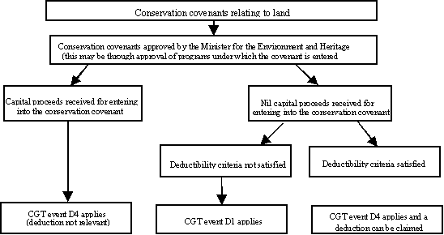
Diagram – Conservation covenants
Div. 31 deduction
Div. 31 deduction & D4

Slide 22
Conservation Covenants
Eligibility (s31-5, 31-15):
Entered into with a fund authority or institution that satisfies subdivision 30B “deductible gift recipients” and is an approved scheme or with a government authority or body (Commonwealth, state, local, territory).
The covenant must be:
On your land (excludes leasehold)
Perpetual, and registered on title (if possible)
Restricts or prohibits activities that could degrade the environmental value of the land.
Is either approved in writing or is entered into under an approve program
You must not receive any money, property or material benefit for entering into the covenant
There must be a decrease in value of the land as a result.
Decrease in value must be more than $5,000 unless land acquired within 12 months.
Note Commissioner determines the decrease in market value, by providing a valuation certificate, the cost of the valuation is passed onto the applicant.

Slide 23
Material benefit for entering into covenant
To obtain the deduction you must not receive any money, property or material benefit for entering into the covenant.
This would exclude covenants under the biodiversity scheme from obtaining a deduction.
Material benefit may exclude payments received to maintain the covenant area. See ATOID 2002/678 – Material benefit
May not exclude carbon credits later claimed.
ATOID 2002/678 Facts:
The DGR has paid for all administrative costs for the covenant.
It has also reimbursed the landowner's legal costs for the covenant.
At the time of the covenant, the landowner and the DGR also entered into a management agreement.
Under the agreement, the DGR provides advice, expertise and services in relation to the covenanted land.
The landowner receives a fencing grant under a government program for land subject to conservation covenant.
The local government rates payable by the landowner on the covenanted land are lowered because of the covenant.
The landowner entered into the covenant to improve the saleability of other land it is developing on the other side of the road.
The value of the developed land has increased because of the covenant.

Slide 24
Material benefit for entering into covenant (ATOID 2002/678)
The reason for decision:
While the landowner has benefited from the lower rates and the fencing grant, they were not received 'for entering into the covenant'.
It is not enough that a conservation covenant is merely prerequisite to receiving an otherwise unrelated benefit. Accordingly, the rate reduction and fencing grant do not prevent a deduction under Division 31.
Any increase in the value of the land on the other side of the road is not a 'material benefit for entering into the covenant'. While there has been an increase in the value of the other land because of the covenant, this is not sufficient to conclude that a material benefit has been received for entering into the covenant.
Also, the landowner's motive of improving the saleability of the other land does not prevent a deduction. A philanthropic or altruistic motive or intention is not a requirement for deduction under Division 31.
Any benefit to the landowner from the DGR under the management agreement is too remote from the covenant. The advice, expertise and services are not 'for entering into the covenant'. Accordingly, they do not prevent deduction under Division 31.
The meeting or reimbursing of the legal and administrative costs by the DGR is not considered to preclude deduction under Division 31.

Slide 25
Conservation covenant- the deduction
Div 31 Deduction equals loss in value of land
Can be (by election) spread over 5 years – does not need to be spread equally, but you are required to stipulate the deduction for each year.
Deduction cannot generate a loss.
Election must be lodged before you lodge your tax return for the first year you entered into the covenant.
You can vary the election, at any time, but only for income years not yet lodged

Slide 26
Conservation covenant example
Bill & Mathilda own a cattle property (purchased for $5M), current MV $10M.
Enter into an approved conservation covenanting program and put in place a conservation covenant.
They lodge a request for valuation – conservation covenant program form with the ATO and pay a non-refundable application fee of $241.
The Commissioner provides a valuation certificate to them outlining the loss in value, as being $1M. Providing all requirements are met, under s31-5, they can claim the $1M deduction in the current year or elect to spread the deduction over 5 years.
The forms:
https://www.dcceew.gov.au/environment/biodiversity/conservation/covenants/how-to-apply
https://www.ato.gov.au/uploadedFiles/Content/SME/Forms/Request_for_valuation_conservation_covenant_program.pdf
https://www.dcceew.gov.au/sites/default/files/documents/apportionment-election-form-conservation-covenants.pdf.pdf

Slide 27
Conservation covenants- D4 event (s104-47) (exception)
No capital proceeds and no Div 31 deduction- exception applies – therefore D1 applies.
No capital proceeds and Div 31 deduction- no exception applies – therefore D4 applies.
Capital proceeds and no Div 31 deduction- no exception applies – therefore D4 applies.
(Capital proceeds and Div 31 deduction is not a possible outcome, because the Div 31 deduction can only be allowed if no material benefit is received.)
Section 104-47 Exceptions
(6) * CGT event D4 does not happen if:
(a) you did not receive any * capital proceeds for entering into the covenant; and
(b) You cannot deduct an amount under Division 31 for entering into the covenant.
Note: In this case, CGT event D1 will apply.
(7) A * capital gain or * capital loss you make is disregarded if you * acquired the land before 20 September 1985.

Slide 28
Conservation Covenants the D4 event
CGT event is when covenant entered into.
CG = capital proceeds received less apportioned cost base of land (104-47(4).
Cost base of land X capital proceeds from entering into covenant
Capital proceeds plus the MV of the land just before you enter the covenant
If no capital proceeds and entitled to Div 31 deduction, then capital proceeds equals the deduction (s116-105).
Section 104.47(3)
You make a * capital gain if the * capital proceeds from entering into the covenant are more than that part of the * cost base of the land that is apportioned to the covenant. You make a * capital loss if those capital proceeds are less than the part of the * reduced cost base of the land that is apportioned to the covenant.

Slide 29
D4 the calculation example- no proceeds
Example 2:
In simple terms and using Bill and Mathilda’s example:
Original cost base $5M
Division 31 deduction $1M
Market value of property after covenant granted $9M
Market value of property before covenant granted $10M
$1M (capital proceeds ie Division 31 deduction) less ($5m / ($1M plus $9M)) = $500,000 capital gain.
Because the gain is from CGT event D4 the general 50% discount may apply.
SBCGT may also apply

Slide 30
D4 the calculation example- proceeds
Example 3:
Varying example 2 such that Bill & Mathilda received capital proceeds of $500,000.
As a result of receiving the capital proceeds, the modification to capital proceeds under section 116-105 does not apply and they would also be denied the Division 31 $1M deduction.
Proceeds received so D4 event occurs and the capital gain would be worked out as follows:
$500,000 –$5M x $500,000 = $236,842
$500,000 plus $9m
Because the gain is from CGT event D4 the general 50% discount may apply.
SBCGT may also apply

Slide 31
Conservation covenants - D1 event
If fail D4 event
Capital gain will equal capital proceeds from creating the right less the incidental costs.
No 50% discount
SBCGT may still apply.
Note 152-12 and 152-35.

Slide 32
Biodiversity agreements and credits
NSW scheme:
On entering into the biodiversity agreement, the landowner provides:
details of the specific actions that the landowner agrees to take to protect and manage the biodiversity values of the site including restricting certain activities.
the number of credits created for the management actions.
the amount of the Total Fund Deposit – which is the present value of the total of all the detailed scheduled managements payments in the agreement.
Final agreement provides the best estimate of the market value of the credits at the creation time. The value of these credits establishes the consideration for entering into the agreement and the cost base of the credits themselves.
The credits will be registered for sale on a public register. The seller and buyer will agree on a selling price. The cost base of the credits would be the first issue value plus incidentals including the total fund deposits. The capital gain being the difference.

Slide 33
Biodiversity agreements and credits
Obligations to manage site
Biodiversity Credits – issued at MV
Biodiversity Credits- sold
Biodiversity Conservation Trust (BCT)
Landowner
Credit Purchaser
cash
Biodiversity agreement
Annual management payments
Cash- Total fund deposit #
Biodiversity Stewardship Fund
# The Present value of the annual management payments over the period of the agreement

Slide 34
Biodiversity agreements
Commissioner accepts the agreements are a conservation covenant for D4 event.
Entering into agreement – D4 event
Capital proceeds would be the value of the credits at issue time
Cost base of land is that part of the cost base that is attributed to the covenant.
No Div 31 deduction as landowner received capital proceeds (biodiversity credits) for entering into the agreement.

Slide 35
Biodiversity credits
A1 event on sale.
Cost base of biodiversity credits equals value at issue time plus incidentals including the Total fund deposit required to be paid on sale of the credits.
Proceeds are what they sell for.
Note a number of private rulings suggest the total fund deposit is an incidental cost of selling the credits.
Whilst Class ruling CR 2009/77 provides for the capital proceeds to be reduced by the amount of the Total Fund deposit.

Slide 36
Biodiversity – site expenses and payments
Under the agreement the landowner is contracted to provide protection and site management.
The landowner is paid by the Biodiversity Stewardship fund to perform those agreed services.
The amount received would be ordinary income under s6-5 and the expenses generally deductible under 8-1.

Slide 37
Carbon Credits (ACCUs)
Other things carbon
What are they
Tax treatment
Division 420
example
Bill before parliament
example
Carbon sequestration rights
Carbon sink forest deductions
Requirements for a deduction
What you can claim
What can’t you claim
Other deductions

Slide 38
Carbon credits – tax accounting for ACCUs
Division 420 is the relevant provision
Provides a taxing mechanism in dealing with the acquisition, holding and surrendering of emission units (which include ACCUs and Kyoto units). Section 420-5 outlines four key features of tax accounting for the emission units:
(1) You bring your gross expenditure and gross proceeds to account, not your net profits and losses on disposal of a registered emissions unit.
(2) The gross expenditure is deductible.
(3) The gross proceeds are assessable income.
(4) You must bring to account any difference between the value of your registered emissions units held at the start and at the end of the income year. This is done in such a way that:
any increase in value is included in assessable income; and
any decrease in value is a deduction ITAA 1997

Slide 39
Choosing closing value at year end
Choice of 3 methods
FIFO
Actual cost method (MV at issue or cost of purchase)
Market value
First year you can choose any method, but the default is FIFO.
Following year’s, you can continue to choose any method except you are precluded from using the cost method if the previous year you used FIFO.

Slide 40
Carbon Credits – Tax Accounting example - purchased
Example 1
Jim bought 200 ACCUs at $50 each (for $10,000) in January 2020. A deduction is available to Jim for the $10,000 for the 19/20 year.
The value of a unit was $60 as at 30 June 2020. Jim chooses the market value method to value the units at year end.
Jim compares the value of the units he held at the start of the year ($nil) to the value at the end of the year ($12,000). Jim includes the $12,000 as income in the 19/20 year. Jim’s taxable income is $2,000 ($12,000 less $10,000).
In the 20/21-year Jim sells the units for $70 each, Jim then needs to include $14,000 (200 x $70) as assessable income in that year. Jim then compares the value of the units at the beginning of the year $60 ($12,000) and the value $nil (sold them all) at the end of 20/21. Jim is entitled to a deduction of $12,000. Jim’s assessable income will be $2,000 ($14,000 less $12,000).

Slide 41
Carbon Credits – Tax Accounting example - issued
Example 2
Jim is issued 200 units instead of buying the units with a market value of $50 each.
As he was issued the ACCUs, he has no purchase deduction and is limited to the costs such as his application and lodgement fees.
He had no ACCUs at the beginning of the year.
He needs to value the units at year end. He can choose any of the three methods:
For the cost method, cost is the market value at issue which was $50.
Market value at year end is $60
FIFO is $50
As he held no ACCUs at the beginning of the year, he would need to include $10,000 (200x $50) or $12,000 (200 x $60) as income in that year.
When he sells them in 20/21 for $70, he would include the $14,000 as income and claim the $10,000 or $12,000 as a deduction.

Slide 42
Treasury Laws Amendment (2023 Measures No. 2) Bill 2023
Comparison of new and current law
New Law | Current Law
Proceeds from selling ACCUs and income derived from farm abatement activities supporting such units, are treated as PP income for PP’s eligibility for concessional tax treatment under the FMD Scheme and tax averaging. | Proceeds from selling ACCUs and income derived from farm abatement activities supporting such units are treated as non-PP income and, accordingly, do not automatically qualify for concessional tax treatment under the FMD Scheme and tax averaging. Eligibility depends on the total amount of non-PP income.
Holders of ACCUs that are carrying on a PP business are taxed based on the net gain from their ACCUs in the year they are sold. Subdivision 420-D is still applicable to trusts. Individual beneficiaries will be taxed on the changes of the value of the Australian carbon credit units which are held by the trust. | Holders of ACCUs are taxed based on changes in the value of their ACCUs each year.

Slide 43
Carbon Credits – Tax Accounting example - new
Example 3:
Applying the facts from example 2:
Jim would only be assessed in 20/21 year for the $14,000 when he sold them.
Jim can include in his primary production income $14,000 and also utilise FMDs to defer the income.
Clearly, this will remove the problems for taxpayers such as landowners where they are issued the ACCUs.

Slide 44
Carbon Credits – Tax Accounting example - new
Example 4
Jim’s family trust owns the land and was issued the 200 ACCUs worth $50 each in 2024 year.
At year end the units were worth $60 each
The family trust would need to include either $10,000 or $12,000 as income in the year.
Jim, as the only beneficiary of the trust, includes the $10,000/$12,000 as income. He cannot treat this amount as primary production income.
When the trustee sells the ACCUs in 2025 for $70 each, Jim includes the $14,000 as income and can claim the $10,000 or $12,000 as a deduction. Leaving him $4,000 or $2,000 as income and to which he can treat as primary production income.

Slide 45
Other things carbon
Carbon sequestration rights
Carbon sink forest deductions
Requirements for a deduction
What you can claim
What can’t you claim
Other deductions

Slide 46
Carbon sink forest
Eligibility
Form
Land and forest for the primary and principal purpose of carbon sequestration by the trees and not for the purpose of felling the trees or using for commercial horticulture and not for use in a managed investment scheme or forestry managed investment scheme.
Trees must meet the requisite forestry characteristics and adhere to certain environmental and natural resource management guidelines.
At the end of the income year the trees must occupy in Australia, a continuous land area of 0.2 hectares or more and at the time the trees are established, it must be more likely than not, that the trees attain a crown cover of 20% or more and reach a height of 2 metres.
.
must complete the form Notice of establishment of trees in a carbon sink forest (NAT 72196) and lodge it with your income tax return or 5 months after the end of the income year, whichever comes first.
https://www.ato.gov.au/business/income-and-deductions-for-business/in-detail/carbon-sink-forests/

Slide 47
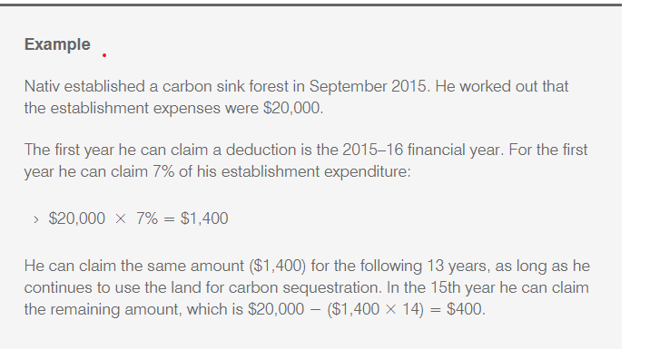
Carbon sink forest
Deductions for capital expenditure
Rate of deduction
Acquiring trees or seed
Raising tree seedlings in pots and potting mixtures
Grafting and germinating
Allowing seeds to germinate
Preparing the area for planting
Planting and
Surveying the planted area.
The deduction rate is 7% of the relevant capital expenditure for 14 years and 105 days.
The period starts from the first day of the income year in which the trees are established, with the 105 days claimed in the 15 year.

Slide 48
Carbon sink forest
What can’t you claim
Other deductible provisions
Access rights
The land – see ATOID 2009/60
Draining swamps or low-lying land or clearing land
Assets separate from the trees such as: fencing, water facilities, roads within forest, fire breaks, and
Carbon credits to be traded in the future.
Section 40-1020 ITAA 1997
Section 8-1 may apply where trees are planted and maintained in the ordinary course of forestry activities (see ATOID 2004/78), or
Subdivision 40-G may apply for Landcare operations (see ATOID 2004/714).

Slide 49
Solar & Wind Farms
Agri tourism and Farm stays
Generally, a lease, but preceded by an option to lease
Lease income
Restructuring opportunities
SBCGT
Active asset?
Passive?
Conducting the business of wind or solar
Income
Grants and indemnities
Tax considerations
Income
Expenses
Non-commercial losses

Slide 50
Concurrent Lease
Example:
Sue owns a property, and enters into a 10-year lease agreement, with 2 x 5 options, with Telstra.
Telstra will install a phone tower.
Sue is paid $15,000 a year.
Consolidated Investments Pty Ltd approaches Sue and offers her $130,000 upfront to take over the lease for 15 years.
Sue takes the money, as it is upfront, and any risk that Telstra may cancel the lease, now rests with Consolidated Investments Pty Ltd.
Consolidated Investments Pty Ltd benefits from an ongoing revenue stream, that they purchased at a discount rate, and will take possession of the land for the remaining 5 years. The extra 5 years may allow them to re-negotiate a new lease with Telstra or another carrier as the old one expires.

Slide 51
Thank you
Please complete your evaluation form

Slide 52
© David Hall 2023
Disclaimer: The material and opinions in this paper are those of the author and not those of The Tax Institute. The Tax Institute did not review the contents of this presentation and does not have any view as to its accuracy. The material and opinions in the paper should not be used or treated as professional advice and readers should rely on their own enquiries in making any decisions concerning their own interests.
Liability limited by a scheme approved under professional standards legislation.

